Slide 1
Introduction to Data Science In R
Pat Callahan
UCSF Memory and Aging Center
8/18/2020
Notes:
Everyone is going to be on mute by default
Feel free to ask questions in the chat, and please note the slide # that your question pertains to.
Data science is a massive field that I think can very broadly be split into understanding statistics and understanding coding
I think most people here are going to be familiar with simple frequentist or Bayesian statistics. Even if that’s not the case, I think there’s a lot of great mentorship available about the MAC regarding what kinds of statistical approaches to take, and how to learn about those.
The coding aspect of data science, however, isn’t always as clear cut. What language does everyone else use? What language should I use? How do I start learning a language? What are the best resources? How do I get things done quickly?

Slide 2
Presentation Overview
R and Data Science
Quick Start Guide
ImpoRtant Topics
Notes:
Goals
My presentation today is to briefly make the case for why you should be using R when it comes to data science,
I’ll give a quick start guide on basic, tangible things you’ll need to do in R
From there, I’ll be covering a variety of topics that will help you better use and understand the R language
My goal is not to give you all of the information on every topic; there’s simply too much to cover, and so I want to do what I can to tie together a lot of these disparate topics into a cohesive story about R and how to use it
More of a starter pack of topics I find to be of practical use
Some of the technical details I’ll give you are half-truths or white lies, and I’ll do my best to let you know when something is a rule vs. an expectation

Slide 3
R History
Primarily derived from the S language
Authors: Ihaka and Gentleman
Initial 1.0 release in February 2000
Reached 4.0.0 in April
Purpose-built as an open-source statistical analysis tool
Notes:
R is mostly derived from the S language developed by Ross Ihaka and Robert Gentleman at the University of Auckland, NZ
First complete release was early 2000, and the latest milestone was reached just back in April as R reached it’s 4th major iteration
When being developed by Ihaka and Gentleman, it was explicitly made as an open-source statistical analysis tool to address what they saw as a shortcoming in this aspect of the research world

Slide 4
R Cons
Technical debt and code oddities
Derived from S, C, and FORTRAN
Obtuse error messages
Ugly base graphics
A maze of open source packages
Steep learning curve
Notes:
Mentioned it’s primarily derived from the S language, but also implements C and FORTRAN. The details here don’t matter except for the fact that operations under-the-hood for R are an amalgamation of languages, and it produces some technical debt—updates can be slow
Hand-in-hand with this technical debt is the fact that some of the error messages are, frankly, obtuse. Even today, I often struggle to really understand error messages that are produced at a low-level and in Base R.
Base graphics are ugly, and customization is poor
Blessing and a curse: options. So many options when it comes to packages.
When it comes to data preparation and visualization, I emphatically recommend the Tidyverse which was the topic of last week’s presentation. I’d strongly encourage you to check out that video if data prep and viz is your primary concern right now.
Biggest problem I come across is that some R fundamentals have a steep learning curve. I encountered this myself when learning R, and I hope

Slide 5
Alternatives
Python
MATLAB
SPSS
Julia
SAS
Notes:
If any of those cons are a dealbreaker, here are some common alternatives particularly within academia
SPSS has been the most popular language for the last 2 decades followed by R
SAS in a far 3rd, followed by MATLAB then everything else
Python good because it’s a common general-purpose language, and has good data science libraries
Julia is the upstart language that could be really big in 10 years—strong emphasis on execution speed

Slide 6
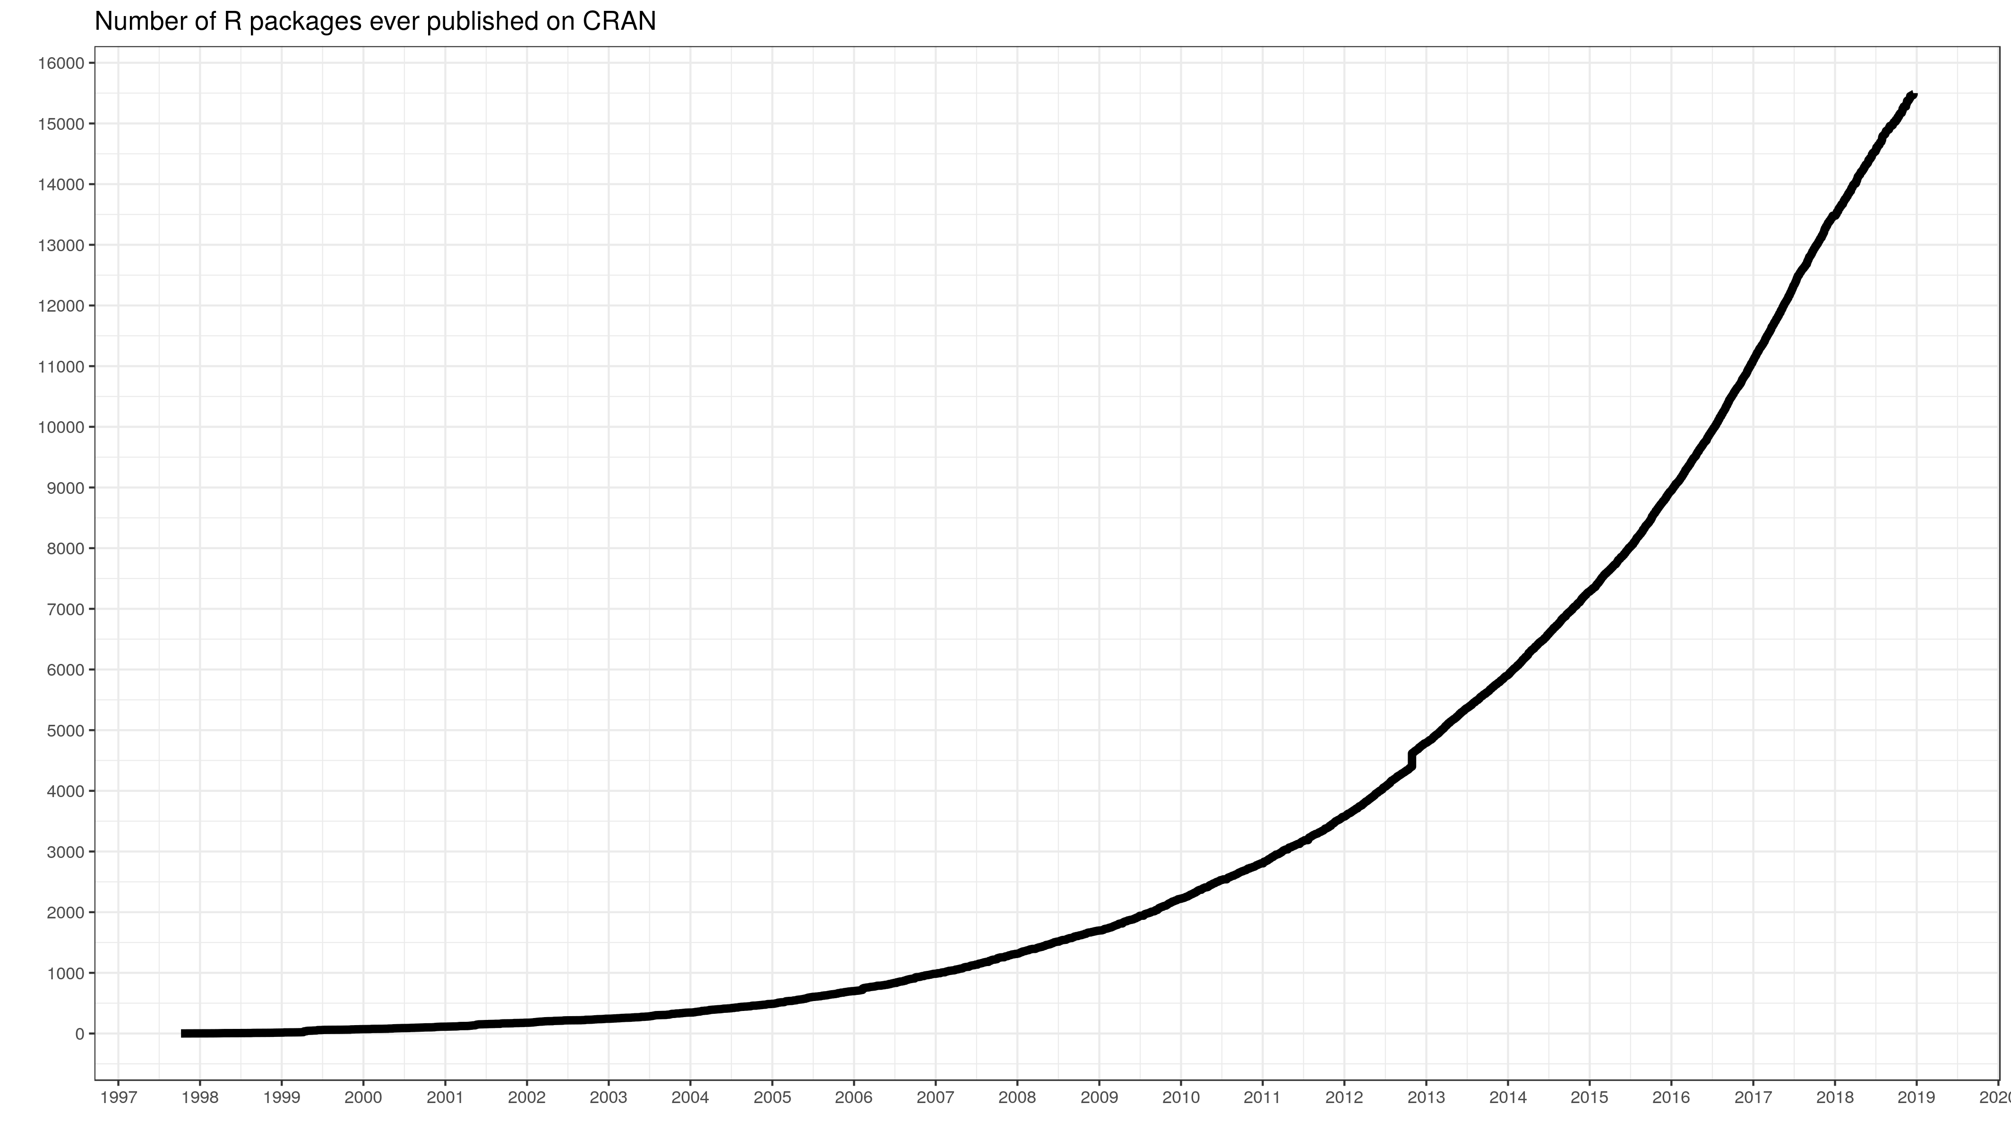
R Pros
Free, now and always!
Documentation and help networks
Stack Overflow, RStudio Community, GitHub, etc.
Standard in research and data science jobs
Widely-taught in universities
Current and future colleagues will know R
Open source packages
>15,000 on CRAN
Notes:
SAS, Stata, SPSS, and MATLAB all cost money, but R is free!
Excellent documentation network; 99% of all questions I’ve ever had about R have already been answered online
Standard in most research or data science jobs
Many universities transitioning to it over MATLAB due to cost and open research initiatives
Anecdote: Berkeley data science courses are now all R, and Berkeley is the largest pipeline of CRCs here
My university actively made the switch while I was a student as well
Package growth from 2000 to 2019, and the breadth of packages is incredible
Everything from QR code generators, to website generators, to machine learning and big data outsourcing packages.
So these are the pros of R. Now, what would be of interest to everyone here as researchers?

Slide 7
Analysis with R
Descriptive and inferential statistics
{stats}, {psych}, {summarytools}
Machine learning
{mlr}*, {caret}, {nlme}
Big data processing
Apache Spark and Hadoop interfaces
Notes:
Functions for descriptive stats such as measures of central tendency, dispersion, and skewness are built into the stats package alongside standard inferential approaches like hypothesis testing, regression analysis, and other population estimates
Psych package extends this to common psych analyses I know are performed at the MAC such as PCA, item response theory, cluster analysis, and more

